Slide 1
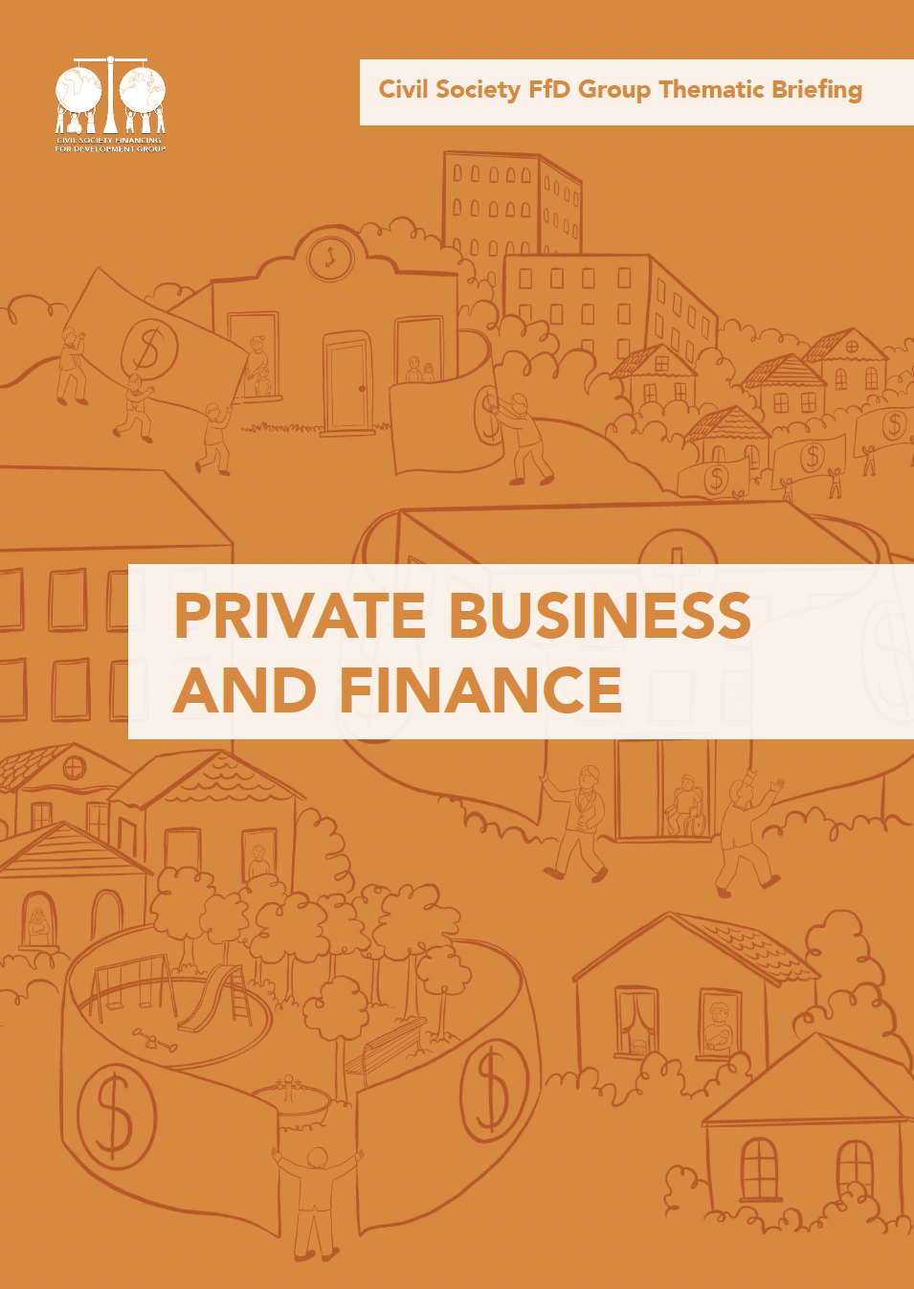
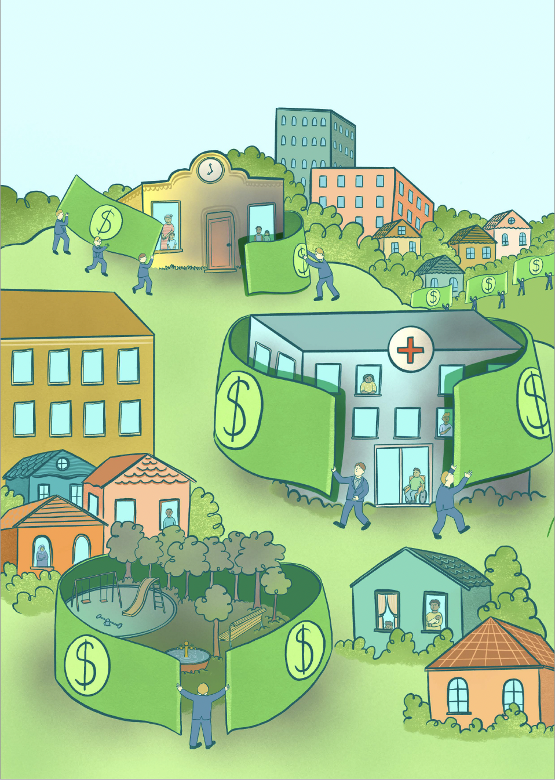
Notes:
Every year, the global development agenda becomes increasingly focussed on attracting private investments to fill the SDGs “financing gap.” This development approach is currently expanded through many fronts. A prominent one consists of the Global Investors for Sustainable Development (GISD) Alliance, a group of 30 business giants (including commercial banks, asset managers and insurance companies) convened by the UNSG “to advise on removing impediments and implementing solutions for scaling up long-term investment for sustainable development.” According to a private finance-first approach, states role should be of removing “regulatory barriers” and de-risking investments in order incentivise private actors that expect guaranteed returns. This approach, however, undermines the important and potentially transformative regulatory role of the state, which can mobilize sustainable financial resources to fund national development strategies without transferring risks from the private sector to taxpayers and the public purse.

Slide 2
A vicious cycle
Governance and rules of the global economy
Environmental, Economic & Social
Extraction
Exploitation
False solutions
ESG and SDG-washing
Export/commodity
Dependence
+
Corporate concentration

Slide 3
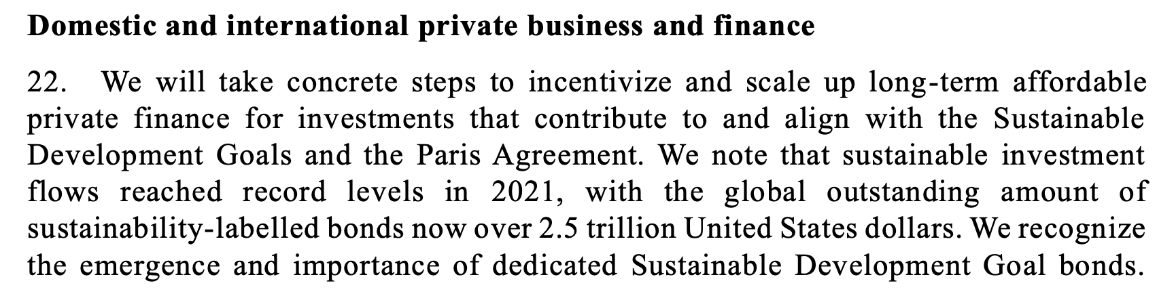
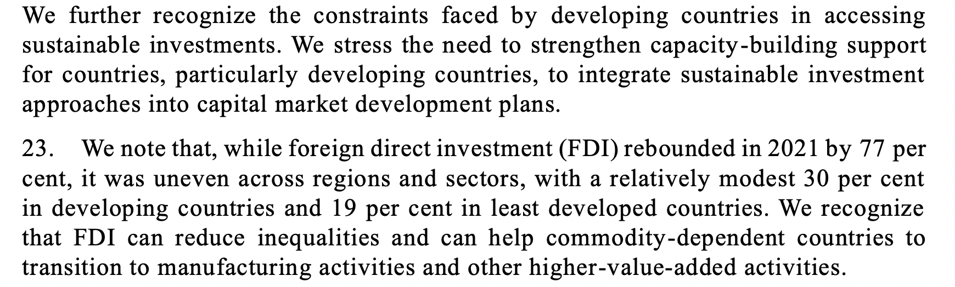



Financing for Development 2022
Focus on boosting private investment in the SDGs and on the SDG bond market
Notes:
UN FfD Conference 2022
Private Finance discussion completely framed around the idea of expanding bond markets
1. What public policies and regulatory frameworks will facilitate the participation of developing countries in the burgeoning SDG bond market?
2. What policy frameworks should be put in place to address information gaps and asymmetries to boost FDI in SDG-relevant sectors in developing countries?

Slide 4


Brazil, ESG and Sustainability-linked Bonds
Two most active corporate issuers of SDG bonds in Brazil: Suzano and JBS - Corporate governance in Latin America and the Caribbean: Using ESG debt instruments to finance sustainable investment projects, UN Economic Commission for Latin America and the Caribbean (ECLAC, March 2022)
JBS: largest meat processor in the world, increased its annual greenhouse gas emissions by 51% between 2016 and 2021, from 280 million metric tonnes to 421.6 million metric tonnes (mmts) - Institute for Agriculture and Trade Policy (IATP)
  Brazil's JBS bought 301,000 cattle from 'irregular' farms in the Amazon, audit finds
  Brazil meat giant JBS vows net zero by 2040 amid record profits (Dom Phillips)
Suzano: Forestry & Paper-Pulp & Paper, the world’s largest pulp exporter.
  Brazil’s Suzano boasts its pulpwood plantations are green; critics disagree
  Suzano and COP26: The Glasgow climate debacle

Slide 5
A critical perspective
Public financing methods are incapable of filling the ‘financing gap’
MDBs and governments should act as facilitators to attract private finance
More private finance is inherently good
Private finance will be allocated in a way that supports the SDGs and reaches those most marginalized
Biased assumptions of a private-first narrative:
Notes:
Flora
First, assuming that traditional public financing methods are incapable of filling the ‘financing gap’ only tells one side of the story. It fails to account for systemic issues that can be tackled through international cooperation and policy choices, yet remain unsolved and continue to further expand such a ‘financing gap’ for developing countries: tax abuse and illicit financial flows; unsustainable and illegitimate debt (or the need for debt architecture reform); predatory trade and investment agreements; (not) meeting internationally-agreed ODA commitments in quantity and quality; and (barriers to) technological transfers (see also Box 3). The current economic order creates the problem and then offers a false, yet profitable, solution to the problem it has itself generated.
Second, the firm belief on private finance as the only solution leads to the assumption that the role of MDBs and governments should be to act as facilitators for private finance as their ultimate end goal. It implies a new, and problematic, way of framing the role of MDBs, namely as institutions that ‘de-risk’ private investments in developing countries, and ‘create markets’ for private investors. In the context of Covid-19 crisis, and the climate emergency, new markets for health and climate infrastructure will likely become ‘investment opportunities’ for institutional investors. Moreover, it implies a redefinition of the role of the state. All too often, the state is defined by its capacity to protect investors’ profits from demand risks attached to commodified infrastructure assets, and from political risks attached to policies that would threaten cash flows, including higher minimum wages, climate regulation and from liquidity and currency risks. But these risks do not disappear, they are all too often transferred to the balance sheet of the state, which is very evident in the case of PPPs.
Third, it assumes more private finance is inherently good, while failing to acknowledge that the type of infrastructure projects designed to attract private investors and generate quick returns might not match the public interest and national priorities.
While it is true that many developing countries face important infrastructure needs – such as schools, hospitals, water, sanitation, electricity and roads – it is not easy to unpack what current estimates of the infrastructure needs include, and one could argue that these figures are calculated on the basis of the mainstream growth-oriented paradigm, which is not ecologically sustainable. For instance, in 2017 the G20’s Global Infrastructure Hub estimated “global infrastructure investment needs of US$94 trillion out to 2040”, and this does not include health and education-related infrastructure. This was “US$15 trillion more than projected spending based on prevailing trends”, which is presented as an “investment gap”. In the context of the Covid-19 pandemic, one could argue that infrastructure financing needs have increased, as countries face the twin burden of projected economic downturns and fiscal distress, on top of the climate crisis.
Fourth, the assumption that private finance will be allocated in a way that supports the SDGs and reaches those most marginalized ignores the fact that investors seek the most profitable investments. This will not lead to sustainably allocating resources to developing countries most affected by climate change, for instance, as that incurs in further risks.
For instance, according to the G20’s Global Infrastructure Hub, private infrastructure investment has been heavily focused on high-income countries, which raises questions even for its own promoters. In 2019 “private infrastructure investment in high-income countries was triple that in low-income countries”. This leads the Hub to state that “at these rates, the mobilisation of private investment in developing countries falls short of international ambitions, with both the scale and amount of investment falling short of what would be needed for transformation.” In response to this, a strong focus is placed on following investors’ needs by creating a pipeline of bankable projects, and promoting greater standardisation of projects, as to make them comparable across countries and over time.

